Slide 1


Effective Communication in the Workplace: A Case Study on Banking Management System

Slide 2


Content:
Effective Communication in the Workplace
A Case Study at FinTech Solutions – Banking Management System
Group Members: Gajanand & Avinash Talreja

Slide 3

Introduction to Workplace Communication
Definition:
Importance:
In Banking Project:
Clear exchange of info between stakeholders.
Ensures teamwork, builds trust, reduces errors.
Emails, client meetings, dashboards, chat updates.

Slide 4

Positive Routine Messages
•Maintain goodwill & share achievements
Project Examples:
Email congratulating dev team after successful online account opening module.
Message to QA team for bug-free ATM cash withdrawal simulation.

Slide 5
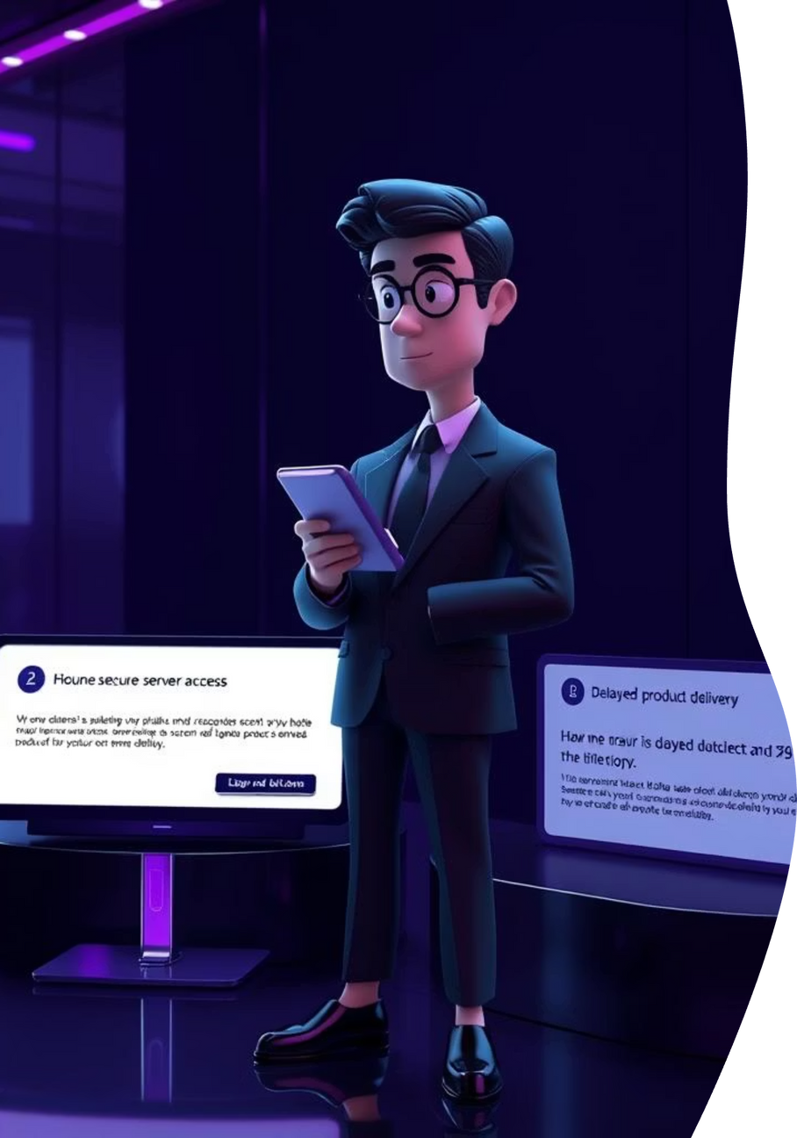
Routine Requests & Claims
Routine Requests = need info/resources
Project Examples:
Request to IT for secure server access for database testing.
Claims = request correction.
Claim to vendor: ATM simulator delivered late, request for extension.

Slide 6


Negative Messages & Buffer Technique
Delivering Negative News
Applying the Buffer
Address project delays or issues directly, while using a buffer to soften the initial impact and preserve goodwill.
Project Example: A delay in loan approval integration. The buffer email states: “Security is our top priority, so extra time is needed to verify loan data encryption.”

Slide 7

Cover Letters, Resumes & Interviewing
Used to hire team members.
Project Examples:
Recruited a cybersecurity intern to handle fraud detection.
Interview Question: “How would you secure customer login data in online banking?”

Slide 8

Informal Reports
•Quick updates for internal tracking
Project Examples:
Slack update: “Card blocking module is now working.”
Email: “This week: completed KYC verification workflow.”

Slide 9

Meeting Agendas & Minutes
Agenda: Plan ahead.
Project Examples:
Minutes: Record outcomes.
Agenda: Discuss loan interest calculation logic.
Minutes: Finalized formula and assigned coding task to Ali.

Slide 10

Presentation Skills in Action
•Strong presentation = visuals + clarity
Project Examples:
Showcased fraud detection alerts dashboard to bank executives.
Used visual graphs to explain transaction volume analysis.

Slide 11


Memos & Letters
Memos: Internal Communication
Letters: External Communication
Memos are used for concise internal communications within an organization.
Letters are formal documents used for external communication with clients, partners, or other outside entities.
Example: Notifying the team about system downtime scheduled for Saturday.
Example: Informing clients that a project is on track and expected for delivery in two weeks.

Slide 12

Tactful Reasoning & Buffer
•Used for sensitive issues
Project Examples:
Tactful Explanation : Delay explained as prioritizing fraud testing for safety

Slide 13



Conclusion
Teamwork & Client Trust
Risk Mitigation & Success
The Right Message at the Right Time
Effective communication fostered strong teamwork and built crucial client trust throughout the project.
Clear communication was instrumental in avoiding conflicts, reducing potential risks, and ensuring the project's overall success.
The key lesson learned is that delivering the right message at the right time is paramount for achieving successful outcomes.

Slide 14
Q&A
We have explored the vital role of effective communication in a banking management system. We now welcome any questions or comments you may have.
Thank you for your time and attention.

